Slide 1

CSE 317 July 2022
Artificial Intelligence
Dr. M A Nayeem
Assistant Professor
CSE, BUET

Slide 2
Learning

Slide 3
Supervised Learning

Slide 4
supervised learning
given a data set of input-output pairs, learn a function to map inputs to outputs

Slide 6
classification
supervised learning task of learning a function mapping an input point to a discrete category

Slide 8
Date | Humidity (relative humidity) | Pressure (sea level, mb) | Rain

Slide 9
Date | Humidity (relative humidity) | Pressure (sea level, mb) | Rain
January 1 | 93% | 999.7 | Rain
January 2 | 49% | 1015.5 | No Rain
January 3 | 79% | 1031.1 | No Rain
January 4 | 65% | 984.9 | Rain
January 5 | 90% | 975.2 | Rain

Slide 10
f(humidity, pressure)
f(93, 999.7) = Rain
f(49, 1015.5) = No Rain
f(79, 1031.1) = No Rain
h(humidity, pressure)

Slide 11
humidity
pressure

Slide 12
humidity
pressure

Slide 13
humidity
pressure

Slide 14
humidity
pressure

Slide 15
humidity
pressure

Slide 16
nearest-neighbor classification
algorithm that, given an input, chooses the class of the nearest data point to that input

Slide 17
humidity
pressure

Slide 18
humidity
pressure

Slide 19
humidity
pressure

Slide 20
humidity
pressure

Slide 21
humidity
pressure

Slide 22
humidity
pressure

Slide 23
k-nearest-neighbor classification
algorithm that, given an input, chooses the most common class out of the k nearest data points to that input

Slide 24
humidity
pressure

Slide 25
humidity
pressure

Slide 26
x1 = Humidity
x2 = Pressure
Rain if w + w1x1
+ w x ≥ 0
h(x1, x2) =
0
2 2
No Rain otherwise

Slide 27
Weight Vector w: (w0, w1, w2)
Input Vector x: (1, x1, x2)
w · x: w0 + w1x1 + w2x2
1 if w + w1x1 + w2x ≥ 0
h(x1, x2) =
0
2
0 otherwise

Slide 28
Weight Vector w: (w0, w1, w2)
Input Vector x: (1, x1, x2)
w · x: w0 + w1x1 + w2x2
_{hw(x) =} 1 if w · x ≥ 0
0 otherwise

Slide 29
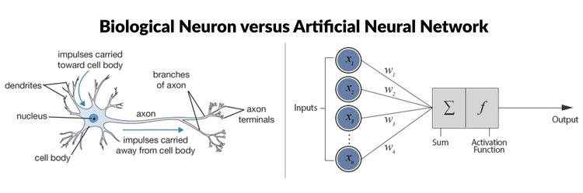

Slide 30
perceptron learning rule
Given data point (x, y), update each weight according to:
wi = wi + α(y - hw(x)) × xi

Slide 31
perceptron learning rule
Given data point (x, y), update each weight according to:
wi = wi + α(actual value - estimate) × xi

Slide 32
1
output
0
w · x

Slide 33
humidity
pressure

Slide 34
humidity
pressure

Slide 35
hard threshold
1
output
0
w · x

Slide 36

soft threshold
1
output
0
w · x

Slide 37
Support Vector Machines

Slide 41
maximum margin separator
boundary that maximizes the distance between any of the data points

Slide 43
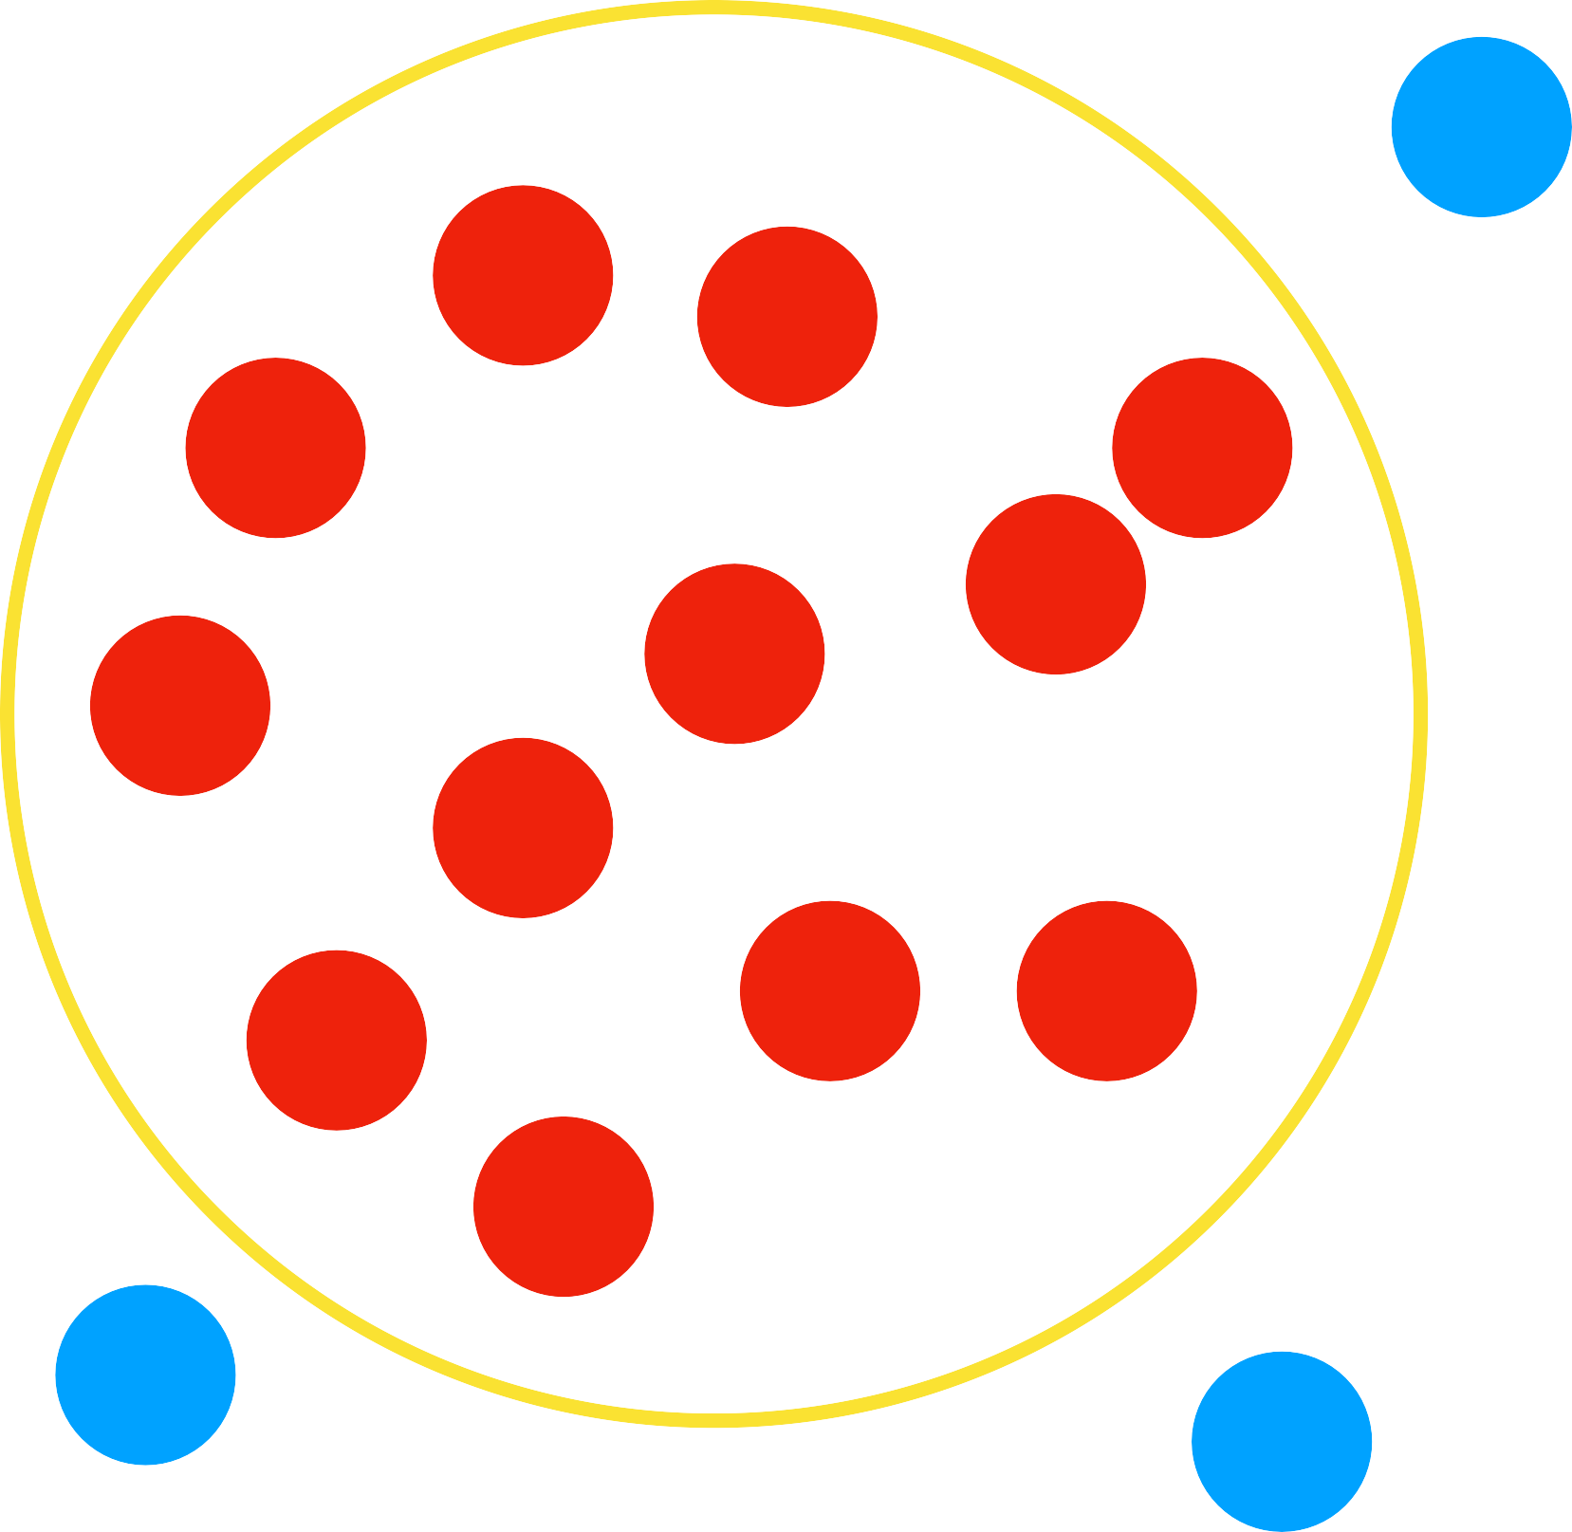

Slide 44
regression
supervised learning task of learning a function mapping an input point to a continuous value

Slide 45
f(advertising)
f(1200) = 5800
f(2800) = 13400
f(1800) = 8400
h(advertising)

Slide 46
advertising
sales

Slide 47
Evaluating Hypotheses

Slide 48
loss function
function that expresses how poorly our hypothesis performs

Slide 49
0-1 loss function
L(actual, predicted) =
if actual = predicted,
otherwise

Slide 50
humidity
pressure

Slide 51
0
0
0
0
0
1
0
0
0
0
0
1
0
pressure
0
0
0
0
0
0
1
0 0
0
0
0
0
1
0
0
0
humidity

Slide 52
L1 loss function
L(actual, predicted) = | actual - predicted |

Slide 53
advertising
sales

Slide 54
sales
advertising

Slide 55
L2 loss function
L(actual, predicted) = (actual - predicted)²

Slide 56
overfitting
a model that fits too closely to a particular data set and therefore may fail to generalize to future data

Slide 57
humidity
pressure

Slide 58
humidity
pressure

Slide 59
humidity
pressure

Slide 60
advertising
sales

Slide 61
advertising
sales

Slide 62
cost(h) = loss(h)

Slide 63
cost(h) = loss(h) +
complexity(h)

Slide 64
cost(h) = loss(h) + λcomplexity(h)

Slide 65
regularization
penalizing hypotheses that are more complex to favor simpler, more general hypotheses
cost(h) = loss(h) + λcomplexity(h)

Slide 66
holdout cross-validation
splitting data into a training set and a
test set, such that learning happens on the training set and is evaluated on the test set

Slide 67
k-fold cross-validation
splitting data into k sets, and experimenting k times, using each set as a test set once, and using remaining data as training set

Slide 68
scikit-learn

Slide 69
Reinforcement Learning

Slide 70
reinforcement learning
given a set of rewards or punishments, learn what actions to take in the future

Slide 71
Environment
state
Agent

Slide 72
Environment
state
action
Agent

Slide 73
Environment
state
reward
action
Agent

Slide 74
Markov Decision Process
model for decision-making, representing states, actions, and their rewards

Slide 75
Markov Decision Process
model for decision-making, representing states, actions, and their rewards

Slide 76
Markov Chain
X0
X1
X2
X3
X4

Slide 79
r
r
r
r
r
r
r
r
r
r
r
r

Slide 80
Markov Decision Process
Set of states S
Set of actions Actions(s)
Transition model P(s' | s, a)
Reward function R(s, a, s')

Slide 93
Q-learning
method for learning a function Q(s, a), estimate of the value of performing action a in state s

Slide 94
Q-learning Overview
Start with Q(s, a) = 0 for all s, a
When we taken an action and receive a reward:
Estimate the value of Q(s, a) based on current reward and expected future rewards
Update Q(s, a) to take into account old estimate as well as our new estimate

Slide 95
Q-learning
Start with Q(s, a) = 0 for all s, a
Every time we take an action a in state s and observe a reward r, we update:
Q(s, a) ← Q(s, a) + α(new value estimate - old value estimate)

Slide 96
Q-learning
Start with Q(s, a) = 0 for all s, a
Every time we take an action a in state s and observe a reward r, we update:
Q(s, a) ← Q(s, a) + α(new value estimate - Q(s, a))

Slide 97
Q-learning
Start with Q(s, a) = 0 for all s, a
Every time we take an action a in state s and observe a reward r, we update:
Q(s, a) ← Q(s, a) + α((r + future reward estimate) - Q(s, a))

Slide 98
Q-learning
Start with Q(s, a) = 0 for all s, a
Every time we take an action a in state s and observe a reward r, we update:
Q(s, a) ← Q(s, a) + α((r + maxa' Q(s', a')) - Q(s, a))

Slide 99
Q-learning
Start with Q(s, a) = 0 for all s, a
Every time we take an action a in state s and observe a reward r, we update:
Q(s, a) ← Q(s, a) + α((r + γ maxa' Q(s', a')) - Q(s, a))

Slide 100
Greedy Decision-Making
When in state s, choose action a with highest Q(s, a)

Slide 103
Explore vs. Exploit

Slide 104
ε-greedy
Set ε equal to how often we want to move randomly.
With probability 1 - ε, choose estimated best move.
With probability ε, choose a random move.

Slide 105
Nim

Slide 107
Player 1

Slide 108
Player 2

Slide 109
Player 1

Slide 110
Player 2

Slide 111
Player 1

Slide 112
Player 2

Slide 113
Player 2 Lost

Slide 114
function approximation
approximating Q(s, a), often by a function combining various features, rather than storing one value for every state-action pair

Slide 115
Unsupervised Learning

Slide 116
unsupervised learning
given input data without any additional feedback, learn patterns

Slide 117
Clustering

Slide 118
clustering
organizing a set of objects into groups in such a way that similar objects tend to be in the same group

Slide 119
Some Clustering Applications
Genetic research
Image segmentation
Market research
Medical imaging
Social network analysis.

Slide 120
k-means clustering
algorithm for clustering data based on repeatedly assigning points to clusters and updating those clusters' centers

Slide 132
Learning
Supervised Learning
Reinforcement Learning
Unsupervised Learning

Slide 133
Thank You ☺

